Slide 1

INSURANCE ANALYTICS PROJECT [P1358]
Executive Dashboard & Business Intelligence Project
A cross-platform analytics solution developed across
Excel, Power BI, Tableau and My SQL to monitor insurance performance.
Prepared For Management & Sales Leaders
Prepared By
Utkarsh Vasistha
Time Period
2019 - 2020 Data
Sales Scope
Cross-Sell, New Business & Renewals

Slide 2



Why This Dashboard Matters
What We Want to Track
Business Value Impact
Sales Targets: Monitor goal attainment for new clients, cross-selling, and renewals.
Faster Cash Collection: Accelerate billing once agreements are signed.
Active Deals Pipeline: Track open negotiations and potential revenue volume.
Unstick Bottlenecks: Mobilize 44 pending opportunities lagging in early stages.
Team Activity: Benchmark client meetings held vs. invoices generated per rep.
Resource Optimization: Direct top talent to high-value enterprise accounts.
Product Demand: Identify top performing coverage types (Health, Fire, Shipping).
Strategic Focus: Realign team incentives towards high-margin product lines.

Slide 3

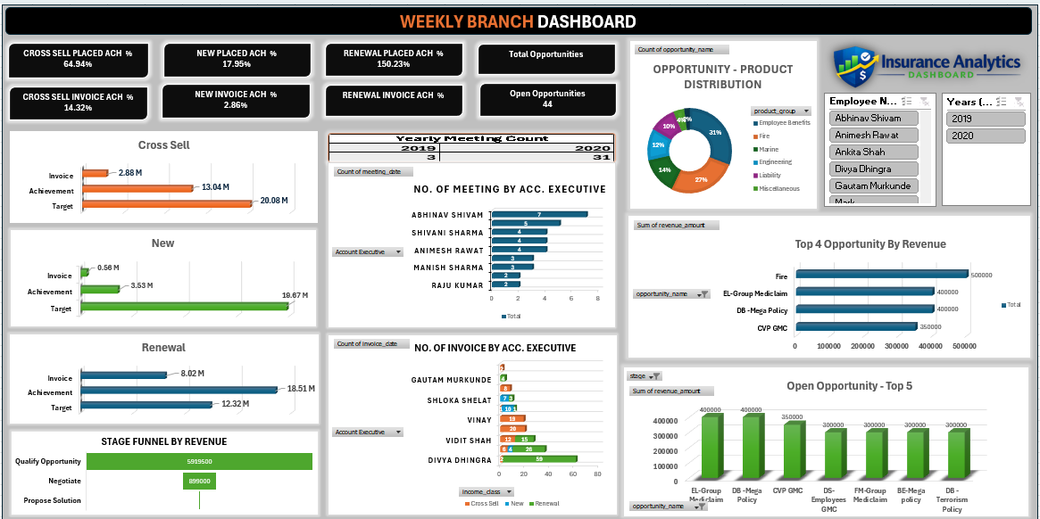
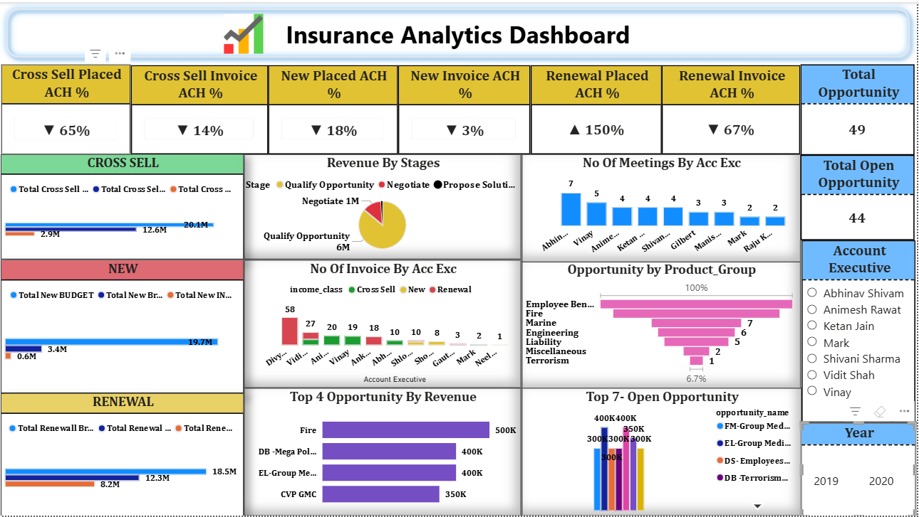
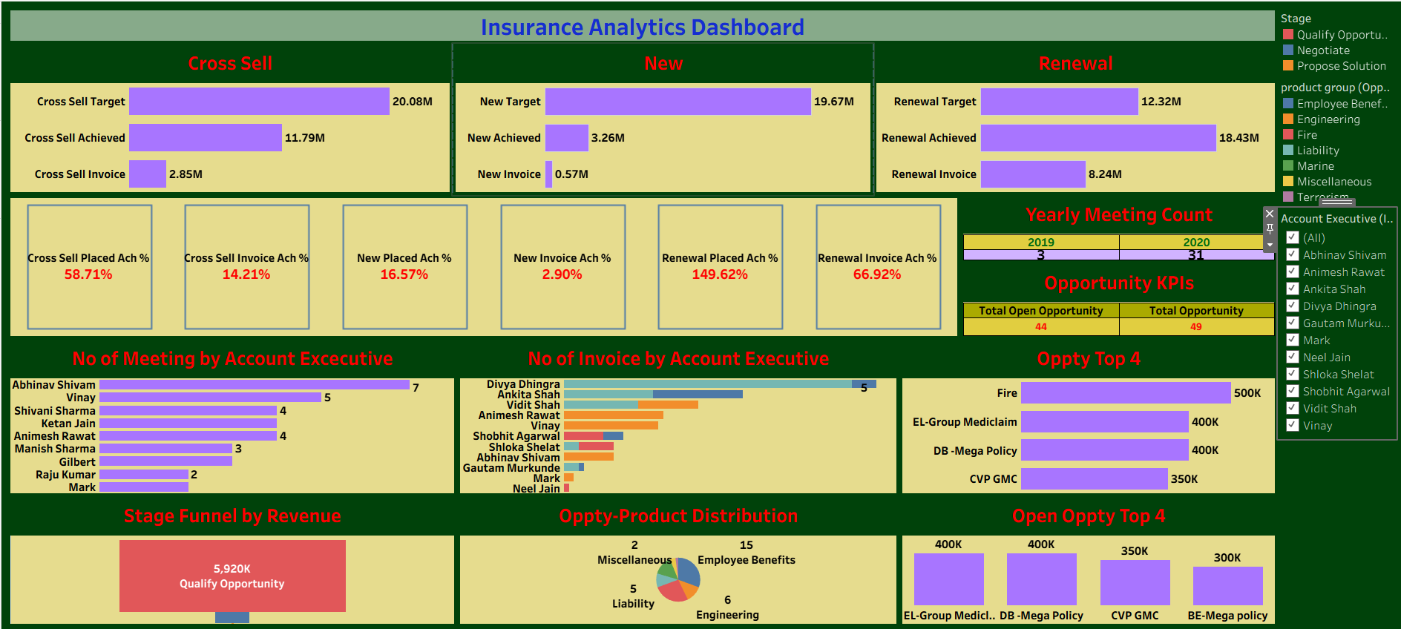
Dashboard Overview & Takeaways
Core Strategic Finding
Our client retention is exceptional (Renewals exceeded target by 50%), but new client acquisition and cross-selling are severely lagging behind targets.
The dashboard consolidates critical operational metrics into 5 key sections: Top Scorecards, Sales Types, Pipeline Stages, Team Effort, and Interactive Filters.
EXCEL
POWER BI
TABLEAU

Slide 4





Performance Against Target Goals
150%
3%
14%
RENEWALS CLOSED
NEW CLIENT CASH BILLED
CROSS-SELL CASH BILLED
50% over total goal budget! Strong existing client loyalty.
Extreme gap: Signed accounts are not being invoiced.
Minimal expansion within our existing client base.
The Retention Success
The Billing Disconnect
Clients trust our services and renew consistently. Renewal closed volume hit 150% of budget ($18.5M vs $12.3M target).
New business deals are signed ($3.4M closed), but almost zero cash ($600K) has been billed to date due to administrative delays.

Slide 5

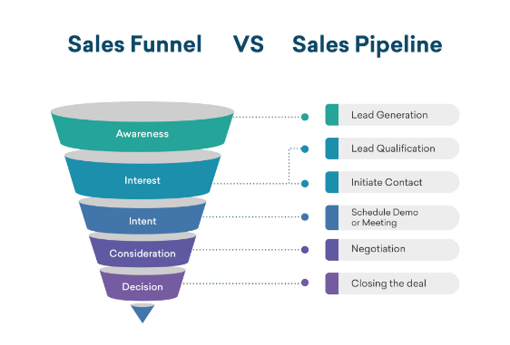
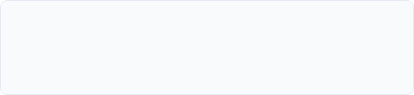
Pipeline Stagnation Analysis
Pipeline Overview
Total Potential Opportunities: 49 Deals
Deals Open/In Progress: 44 Deals (90% Unclosed)
Stage 1 (Checking Details): $6.0M (85.7% of total revenue) sits stalled in the earliest qualification phase.
Stage 2 (Final Talks): Only $1.0M (14.3%) has progressed to final negotiations.
Core Issue: Sales reps are not driving fast momentum after initial discovery calls.

Slide 6

Sales Revenue Breakdown by Type
Sales Stream Category | Target Budget ($M) | Deals Closed ($M) | Cash Billed ($M) | Variance vs Target
Renewals (Existing Clients) | $12.3M | $18.5M | $8.2M | +50% Closed / -33% Billed
Cross-Sell (Policy Add-ons) | $20.0M | $13.0M | $3.0M | Short by $17.0M Cash
New Business (New Clients) | $19.7M | $3.4M | $0.6M | Severe Underperformance
Key Takeaway: Closed agreements total $34.9M, but actual collected/billed revenue is only $11.8M across all lines—leaving an immediate $23.1M gap in unrealized potential revenue.

Slide 7







Insurance Policy Demand & Distribution
Employee Benefits
Fire Cover
Marine & Engineering
Specialty Cover
#1 Most Popular Line
#2 Preferred Choice
Growth Opportunity
Group health & staff coverage represents our highest corporate demand and primary deal driver.
Commercial property and fire risk protection form our steady foundation for corporate accounts.
Steady Volume
Niche offerings like Terrorism insurance are rarely pitched—unlocked market potential.
7 Marine and 6 Engineering deals closed. Reliable medium-ticket business lines.

Slide 8



Top Potential Deals to Close
Focusing executive resources on the top 4 pending accounts will yield immediate high-margin returns:
Deal Description | Value | Status Stage
Fire Insurance Deal | $500,000 | Finalizing
Commercial Package | $400,000 | Negotiation
Group Health Plan | $400,000 | Checking Info
Staff Medical Policy | $350,000 | Proposal Sent
Closing just these top 4 deals yields $1.65 Million instantly!

Slide 9


Sales Team Activity vs Billing Output
Client Meetings Held
Invoices (Bills) Created
Sales Representative | Meetings | Activity Level
Abhinav Shivam | 7 | High
Vinay | 5 | High
Animesh / Ketan / Shivani | 4 each | Medium
Gilbert / Manish | 3 each | Medium
Sales Rep | Bills Sent | Primary Focus
Divy... | 58 | Mostly Renewals
Vidi... | 27 | Renewals & New
Animesh / Vinay / Ankur | 18 - 20 | Mix of Deals
Abhinav / Shlok / Shobhit | 8 - 10 | Early Stage

Slide 10






The 3 Main Operational Challenges
1. Paperwork Bottlenecks
2. Early Pipeline Stagnation
3. Disproportionate Workload
Delayed Invoicing
We win agreements, but delay sending bills ($18.5M closed renewals vs. only $8.2M actually billed).
Stalled Discussions
Uneven Rep Output
$6.0M out of $7.0M in prospective sales sits unprogressed in Stage 1 without active rep follow-ups.
Divy generated 58 bills single-handedly, while 5 other sales reps combined created under 10 bills.

Slide 11








Strategic Action Plan & Milestones
Immediate Billing Rule
Pipeline Sprint
Executive Closing
Incentive Alignment
Mandate instant billing upon deal agreement to capture the $18.5M in unbilled renewals.
Hold weekly reviews to unstick $6M in Stage 1 deals and accelerate follow-ups.
Engage senior leadership to co-pitch and close the top 4 enterprise accounts ($1.65M).
Align commissions to encourage cross-selling and set minimum 5 client meetings/week.

Slide 12
Conclusion
Unlocking Over $15 Million
By streamlining our invoicing process for closed deals and aggressively supporting our sales team to advance early-stage opportunities, we can capture over $15M in immediate cash reserves.

Slide 13


Thank You
We appreciate your time and attention.

